Slide 1


The FYP ACCELERATOR
Android Based Lung Cancer Detection using Machine Learning
Sir Syed University of Engineering & Technology.
Demo
April 07th, 2021

Slide 2
Problem Statement
Lung cancer is considered as one of the serious diseases in the world. Many imaging techniques are used to detect cancer like chest X-Ray, PET, CT, and MRI etc. While comparing among them CT scan imaging is the best imaging technique to detect cancer. Radiologists strive to detect and interpret lung cancer from CT scan image by prolong interpretive process, is time consuming. Interpretation from complex structure nodules from CT scan is difficult and requires several days process. Hence, it is helpful for radiologists and doctors to use computer aided technique because early detection of lung cancer can save patient's life and radiography students to gain better knowledge.

Slide 3
Problem Statement
Android based Lung Cancer Detection using ANN is an android application which allows user to upload their CT scan image in app, which then detects a lung cancer from CT scan image. It will provide a platform to easily detect the lung cancer from CT scan for radiologists to interpret the result within a short period of time.
In short, we have created a detecting application which is user friendly and provide quick results.

Slide 4
Proposed Solution
We have implemented an Android based Lung Cancer Detection System using Deep Learning which targets the early detection of lung cancer from a CT scan image within a short space of time. Our proposed model provides a graphical user interface which is developed to scan the CT scan images and display the detected cancer along with features like Area, Perimeter, Eccentricity & Diameter in just few clicks.

Slide 5
Technology Stack
Front End Technology:
XMl
Backend Technology:
Programming Language : Java
Database: SQLite
Library : OpenCV
Tools:
Android Studio
Adobe Photoshop
Camtesia
Image Converter

Slide 6
Target Market
The target market of our app is medical. The main objective of this application is to facilitate radiologists. With the capability of responsive technology, the users will be able to gain better understanding of CT scan image result.

Slide 7

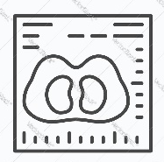




Business Model
Upload Image
Pre Processing
Initiates
Android App
Image
Access
Image Processing
User
Diagnosis Result
Save data
Database
Detected Cancer Detail

Slide 8
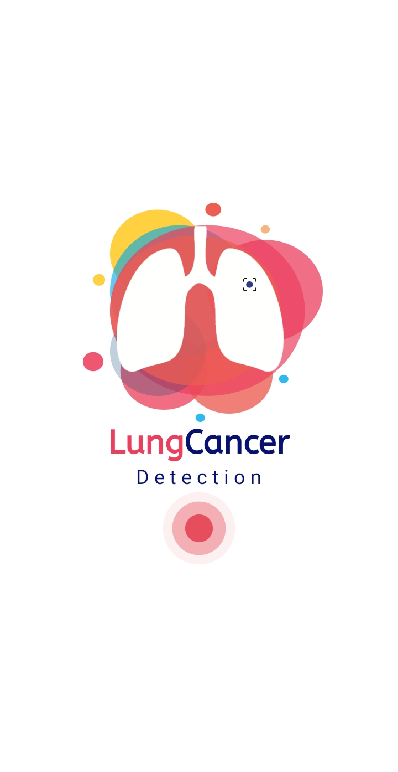
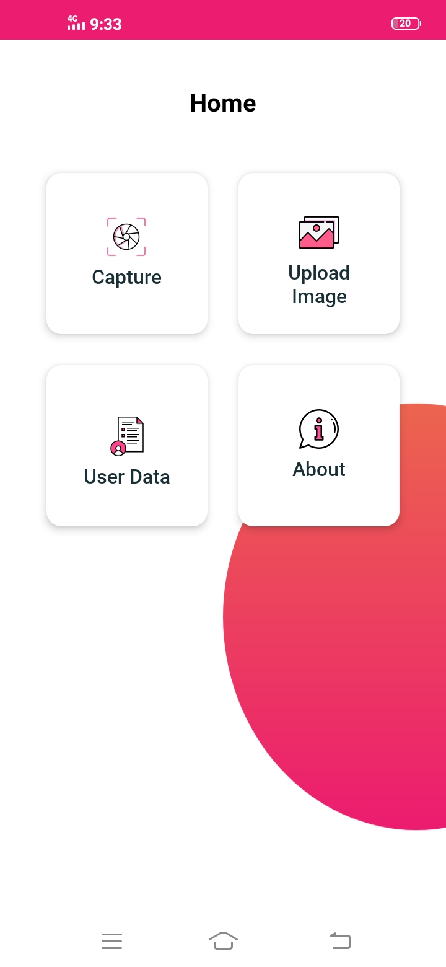
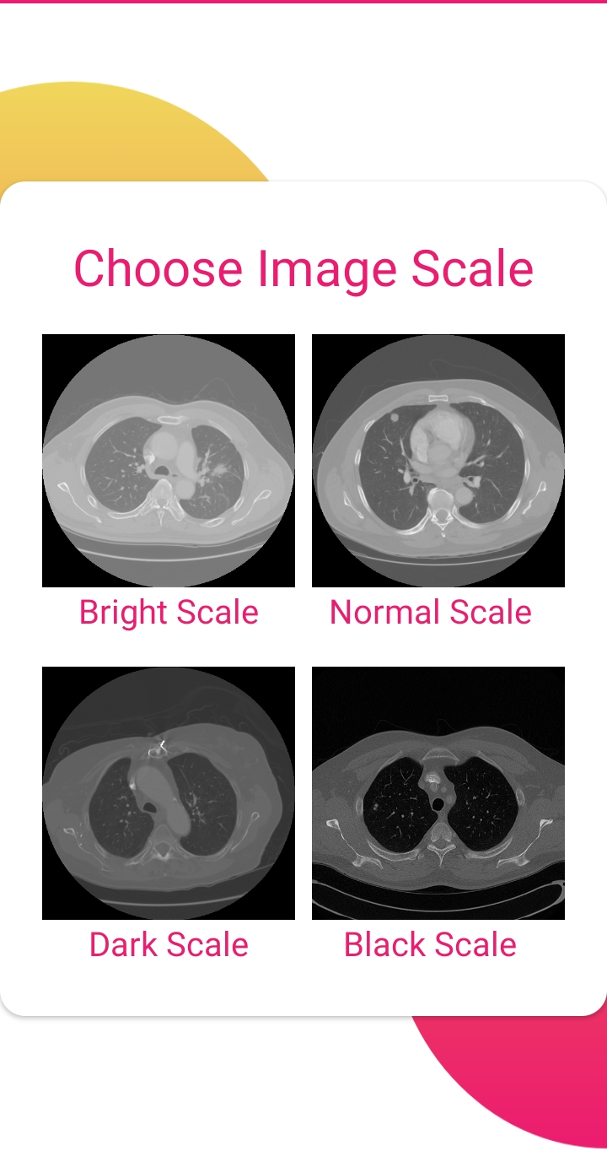
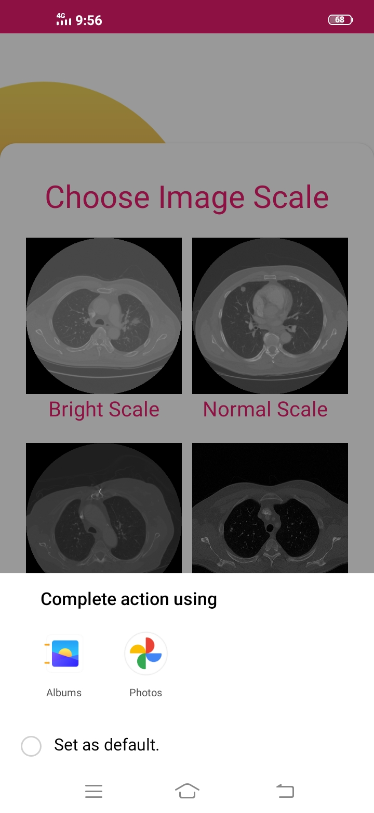
Walkthrough

Slide 9
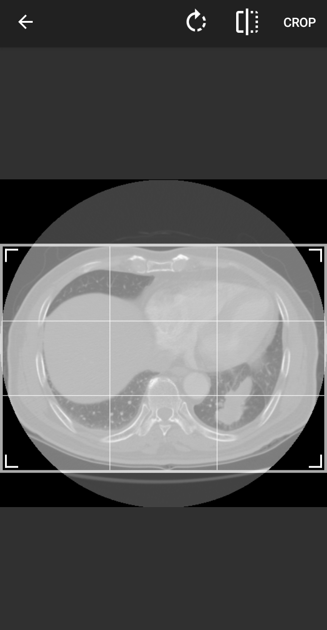
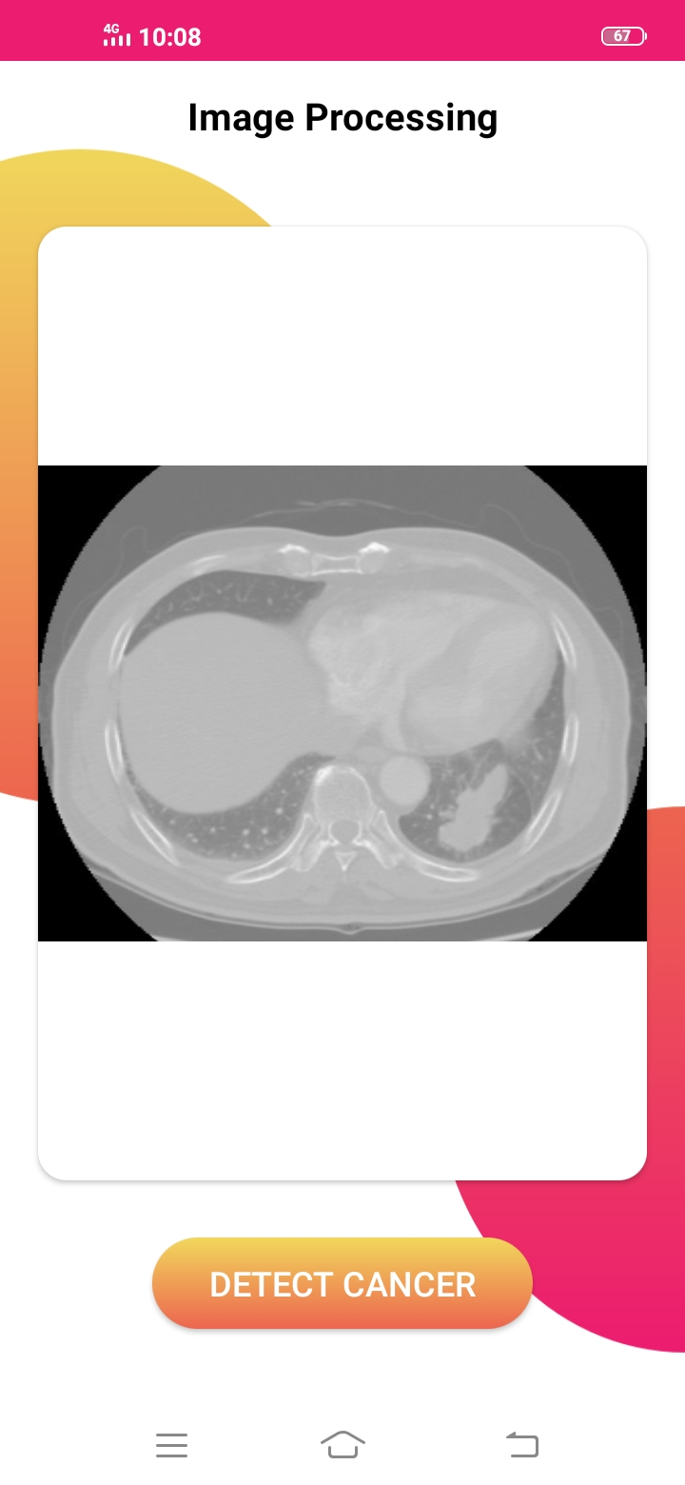
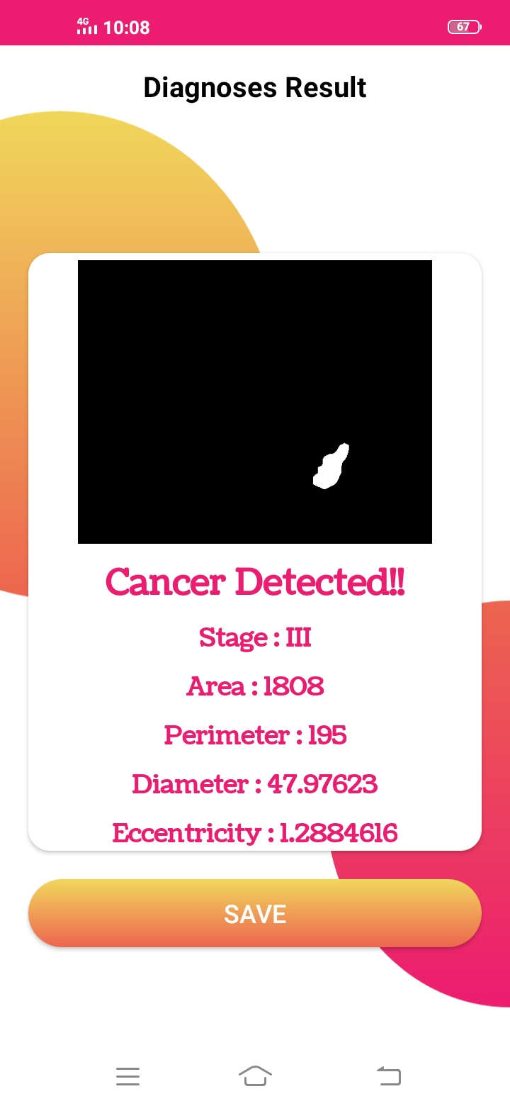
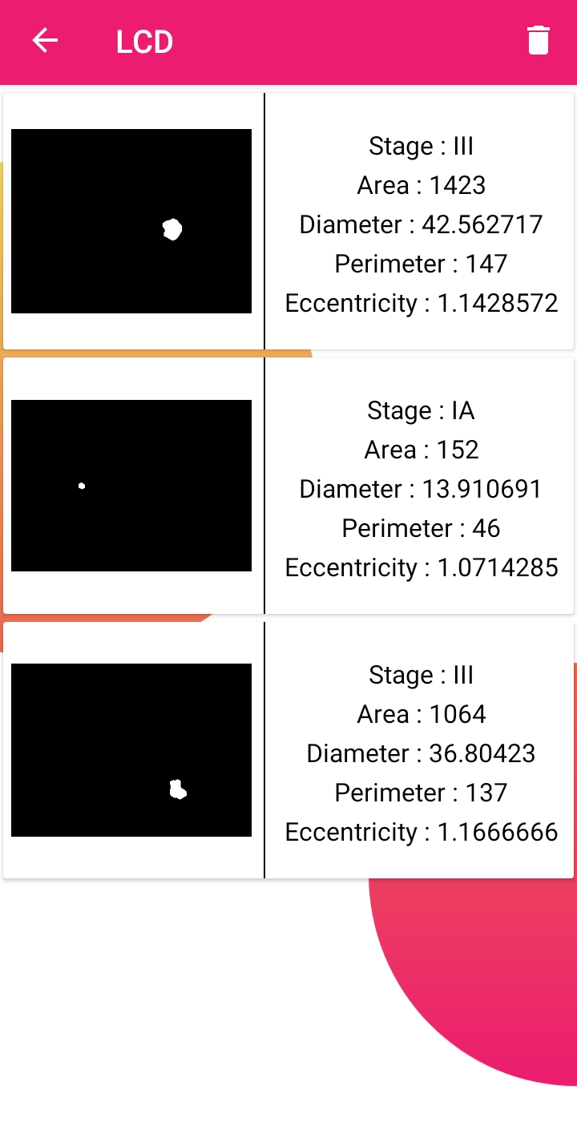
Walkthrough

Slide 10
Future Work
- Classification of Lung cancer into different stages like Stage (I, II, III & IV).
- Gather more dataset to increase the efficiency and accuracy of model.

Slide 11
Questions
fyp@tenpearls.com

